Slide 1
Future Milk Prices
John Ross Valderama

Slide 2
Features
Data used to predict milk prices:
Milk Sales Prices
Block Cheddar Sales
Barrel Cheddar Sales

Slide 3
Trends
Milk produced per cow has increased each year.
2017: 23149
Decline in milk cows until 2010 with a slight increase each year.
Price of milk held steady around $12 to $13 until 2010.
2010+ milk prices were $16+

Slide 4
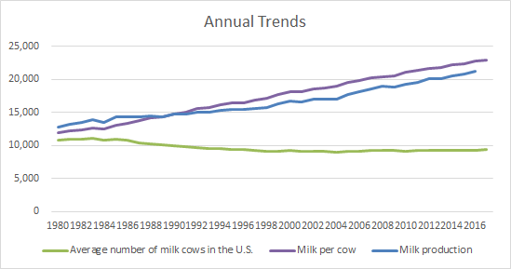
Trends

Slide 5
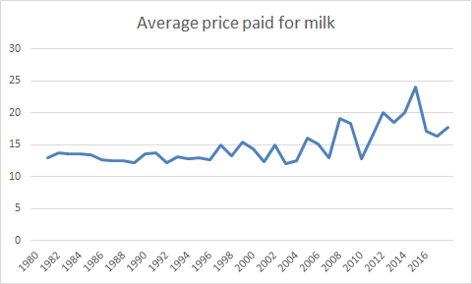
Milk Prices

Slide 6
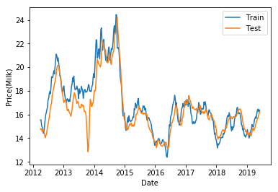
Model: Training

Slide 7
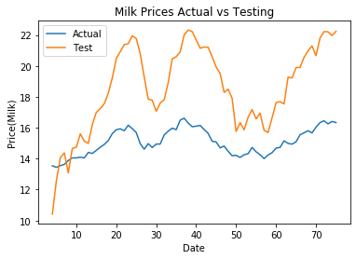
Model: Testing

Slide 8
Next Steps
With the current observations it’s not enough for a neural network.
To improve the model:
Acquire more data
Try alternative models:
Statistical Machine Learning

